Slide 1
Abstract algebra ch 12 intro to rings

Slide 2
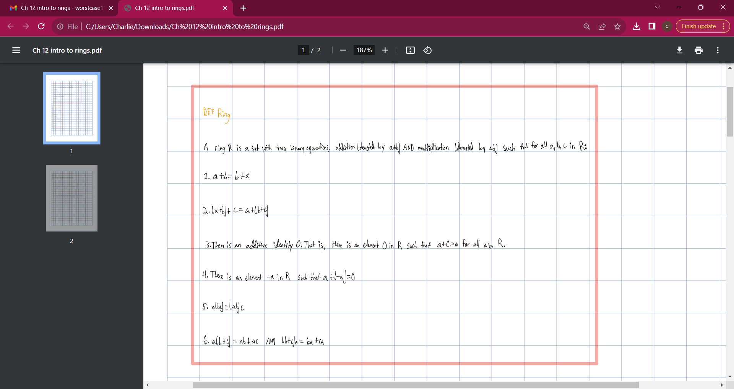

Slide 3
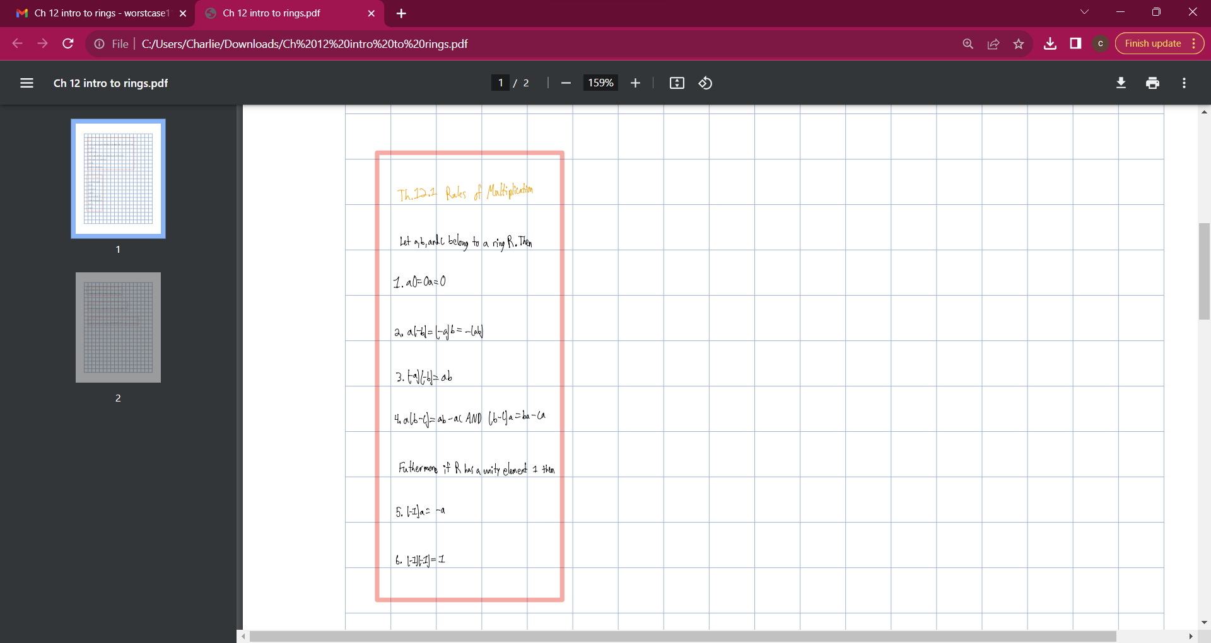

Slide 4
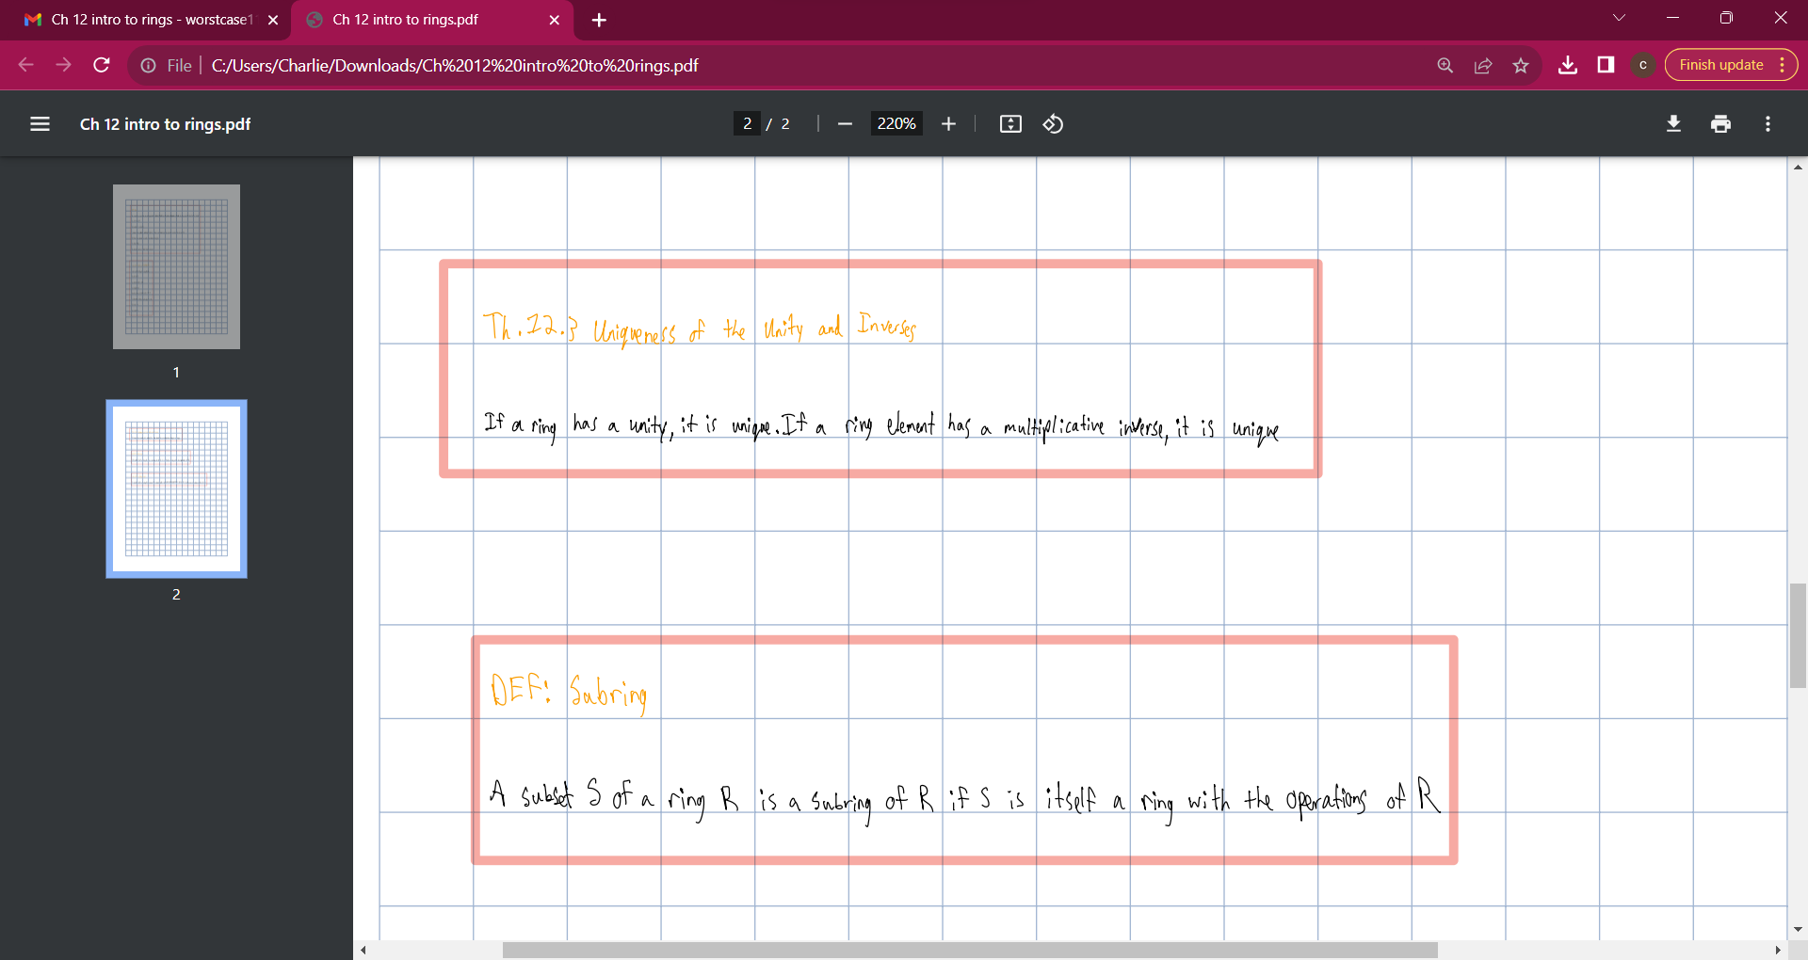

Slide 5
